Slide 1
Agrégation spatiotemporelle pour la visualisation de traces d’exécution
Damien Dosimont
Advisor: Guillaume Huard – Co-advisor: Jean-Marc Vincent

Slide 2



In a few words…
Analysis of large execution traces, provided by
multimedia/embedded applications
parallel/scientific computing applications
Design of a method based on
visualization
data aggregation
interaction
following a top down approach
Design and implementation in an analysis software

Slide 3
Summary

Slide 4

Context

Slide 5








Embedded systems are everywhere!
SoC-Trace

Slide 6





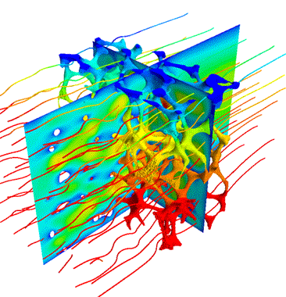







Large scale parallel and distributed systems too

Slide 7

Both are complex
?
How to analyze applications?

Slide 8


Main thread: a recording application
Streaming
Record
TV program
Set-top box
Hard drive
TS Record use case

Slide 9

May the quality of service be with you

Slide 10


QoS not respected !
Loss of frames, sound artifacts
i find Your lack of qos disturbing

Slide 11


Knowledge on TS Record use case
IP buffers
Memory
Hard drive
IP packets
sys_write()
flush-8:0
every
100 ms
Disk cache
every
5000 ms
230 KB

Slide 12



How to debug our application?
Classic step-by-step debugger (ex: GDB) not compatible with streaming/real time aspect
Tracing: collect information about the execution and save them in a file
Analyze the content post-mortem
Visualization techniques

Slide 13
Visualize structure and temporal behavior
Space-time diagram inspired by Gantt Chart
Exemple of a sequential pattern with context switches
Exemple of a parallel execution with communications

Slide 14
The idea
How we imagine analyzing the application
Exemple of a sequential pattern with context switches
Exemple of a parallel execution with communications

Slide 15





What about scalability?

Slide 16





Shneiderman’s mantra
Overview first,
Zoom
and
Filter,
then
Details-
on-demand
}

Slide 17
Visualization support

Slide 18
Performance

Slide 19
User

Slide 20
Shneiderman’s mantra
Overview first,
Zoom
and
Filter,
then
Details-
on-demand
}

Slide 21
Publications
International Conferences
A Spatiotemporal Data Aggregation Technique for Performance Analysis of Large-scale Execution Traces. Damien Dosimont, Robin Lamarche-Perrin, Lucas Mello Schorr, Guillaume Huard, Jean-Marc Vincent, IEEE Cluster 2014, pages 149-157, Madrid, September 2014.
Efficient Analysis Methodology For Huge Application Traces. Damien Dosimont, Generoso Pagano, Guillaume Huard, Vania Marangozova-Martin, Jean-Marc Vincent, 2014 International Conference on High Performance Computing & Simulation, pages 951-958, Bologna, June 2014.
Trace Management and Analysis for Embedded Systems. Generoso Pagano, Damien Dosimont, Guillaume Huard, Vania Marangozova-Martin, Jean-Marc Vincent, 2013 IEEE 7th International Symposium on Embedded Multicore Socs (MCSoC), pages 119-122, Tokyo, September 2013.
Workshops
Ocelotl: Large Trace Overviews Based on Multidimensional Data Aggregation. Damien Dosimont, Youenn Corre, Lucas Mello Schnorr, Guillaume Huard, Jean-Marc Vincent, 8th International Parallel Tools Workshop (IPTW’14), Stuttgart, October 2014.
Agrégation temporelle pour l’analyse de traces volumineuses. Damien Dosimont, Guillaume Huard, Jean-Marc Vincent, 10ème Atelier en Evaluation de Performances, Sophia Antipolis, June 2014.
La visualisation de traces, support à l’analyse, déverminage et optimisation d’applications de calcul haute performance. Damien Dosimont, Guillaume Huard, Jean-Marc Vincent, Atelier Visualisation d’informations, interaction et fouille de données (VIF) de la 13e Conférence Francophone sur l’Extraction et la Gestion des Connaissances (EGC’2013), pages 55-66, Toulouse, January 2013.

